Slide 1
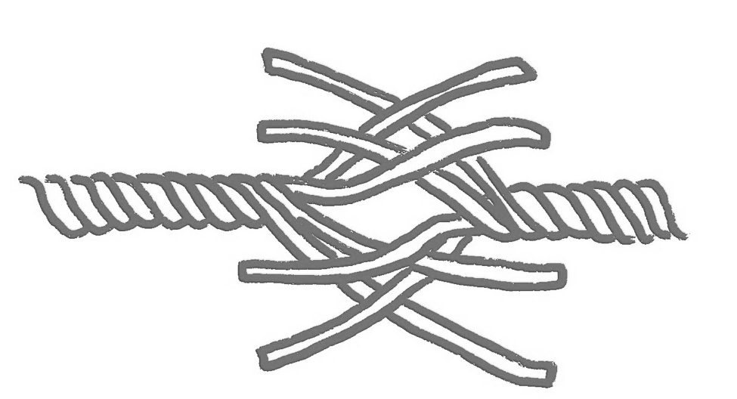
Cognition | … to know the subject and what it is important for you to learn right now … to know how to teach / learn the specific subject … to explain and model what I think is important about my subject and your learning
… to build knowledge, skills, competences yourself … to engage with the course materials and activities | Cognition
How teachers can build trust with students (in the presence of GenAI)
Affect | … to care about you and your learning … to do my best to create the best conditions for your learning … to react kindly to mistakes … to make rules transparent
… to come and talk to me if things aren’t going well … to contribute constructively to the class | Affect
Trust me, the teacher, …
I trust you, the student, …
Values | … to care about my own professional development … to be open about what I expect and how I check your work … to be transparent about my practice
… to care about your learning … to commit to what we do together in the course … to reflect on your learning process and outcomes | Values
Forsyth & Glessmer (2026)
Keynote at SU’s Teachers' Conference 2026 — Teaching for Democracy and Sustainability
Identity | … to be interested in knowing what you are thinking
… to share your own thoughts with me | Identity

Slide 2
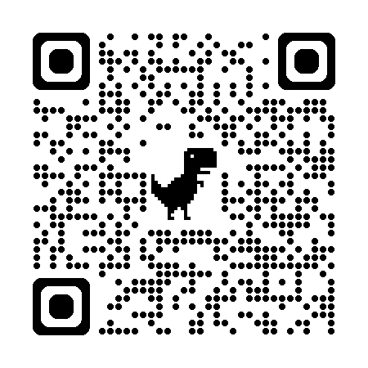
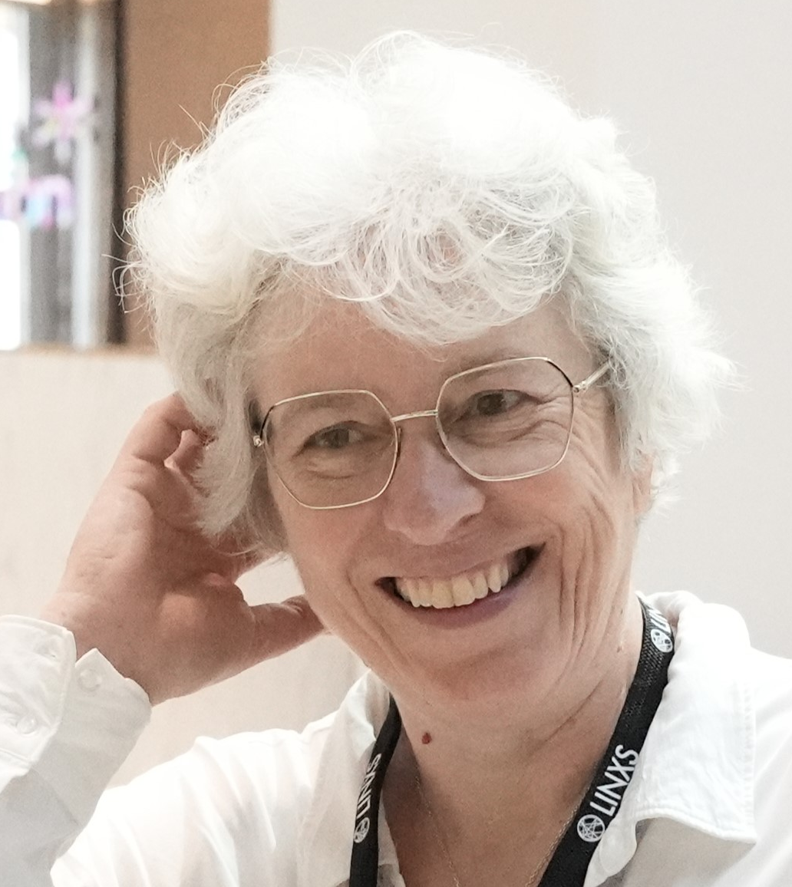
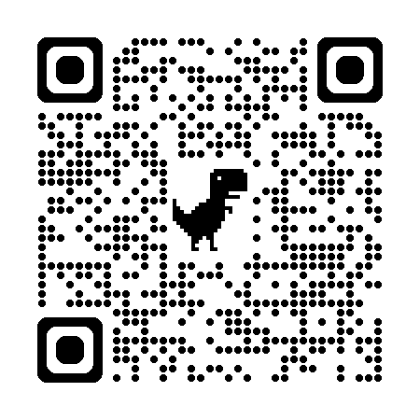
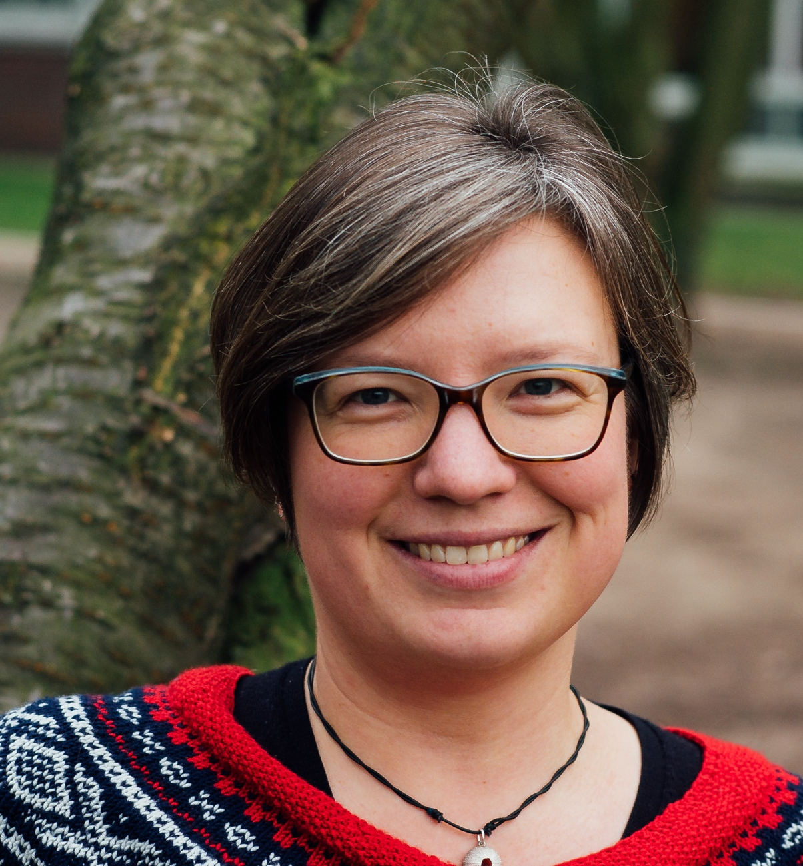
On the backside of this “bordpratare”, we present moves that teachers can consider to build trust with their students – in general and specifically also in the presence of GenAI.
We share them for inspiration and you are welcome to modify them to whatever fits your context and purpose. Please discuss them with your colleagues, and more importantly, discuss them with your students!
What else do you do to build trust in the classroom?
Let us know!
Find out more!
Connect with us!
Read the pilot study:
How teachers build trust with students in the presence of GenAI
(Forsyth & Glessmer, 2025)
https://www.lth.se/fileadmin/cee/genombrottet/konferens2025/C1_Forsyth_Glessmer.pdf
Rachel Forsyth
rachel.forsyth@education.lu.se
https://assessmentinhe.wordpress.com
Watch us talk about this research (15 mins)
https://onehe.org/resources/building-trust-with-students-in-the-genai-era/
Mirjam S. Glessmer
mirjam.glessmer@lth.lu.se
https://mirjamglessmer.com

