Slide 1
A Library Infrastructure for the Practices of Scholarly Communication
Sofie Wennström, Analyst, Dept. of Quality
Stockholm University Library
@SofieWennstrom @SthlmUniLib @SthlmUniPress
E-mail: sofie.wennstrom@sub.su.se

Slide 2
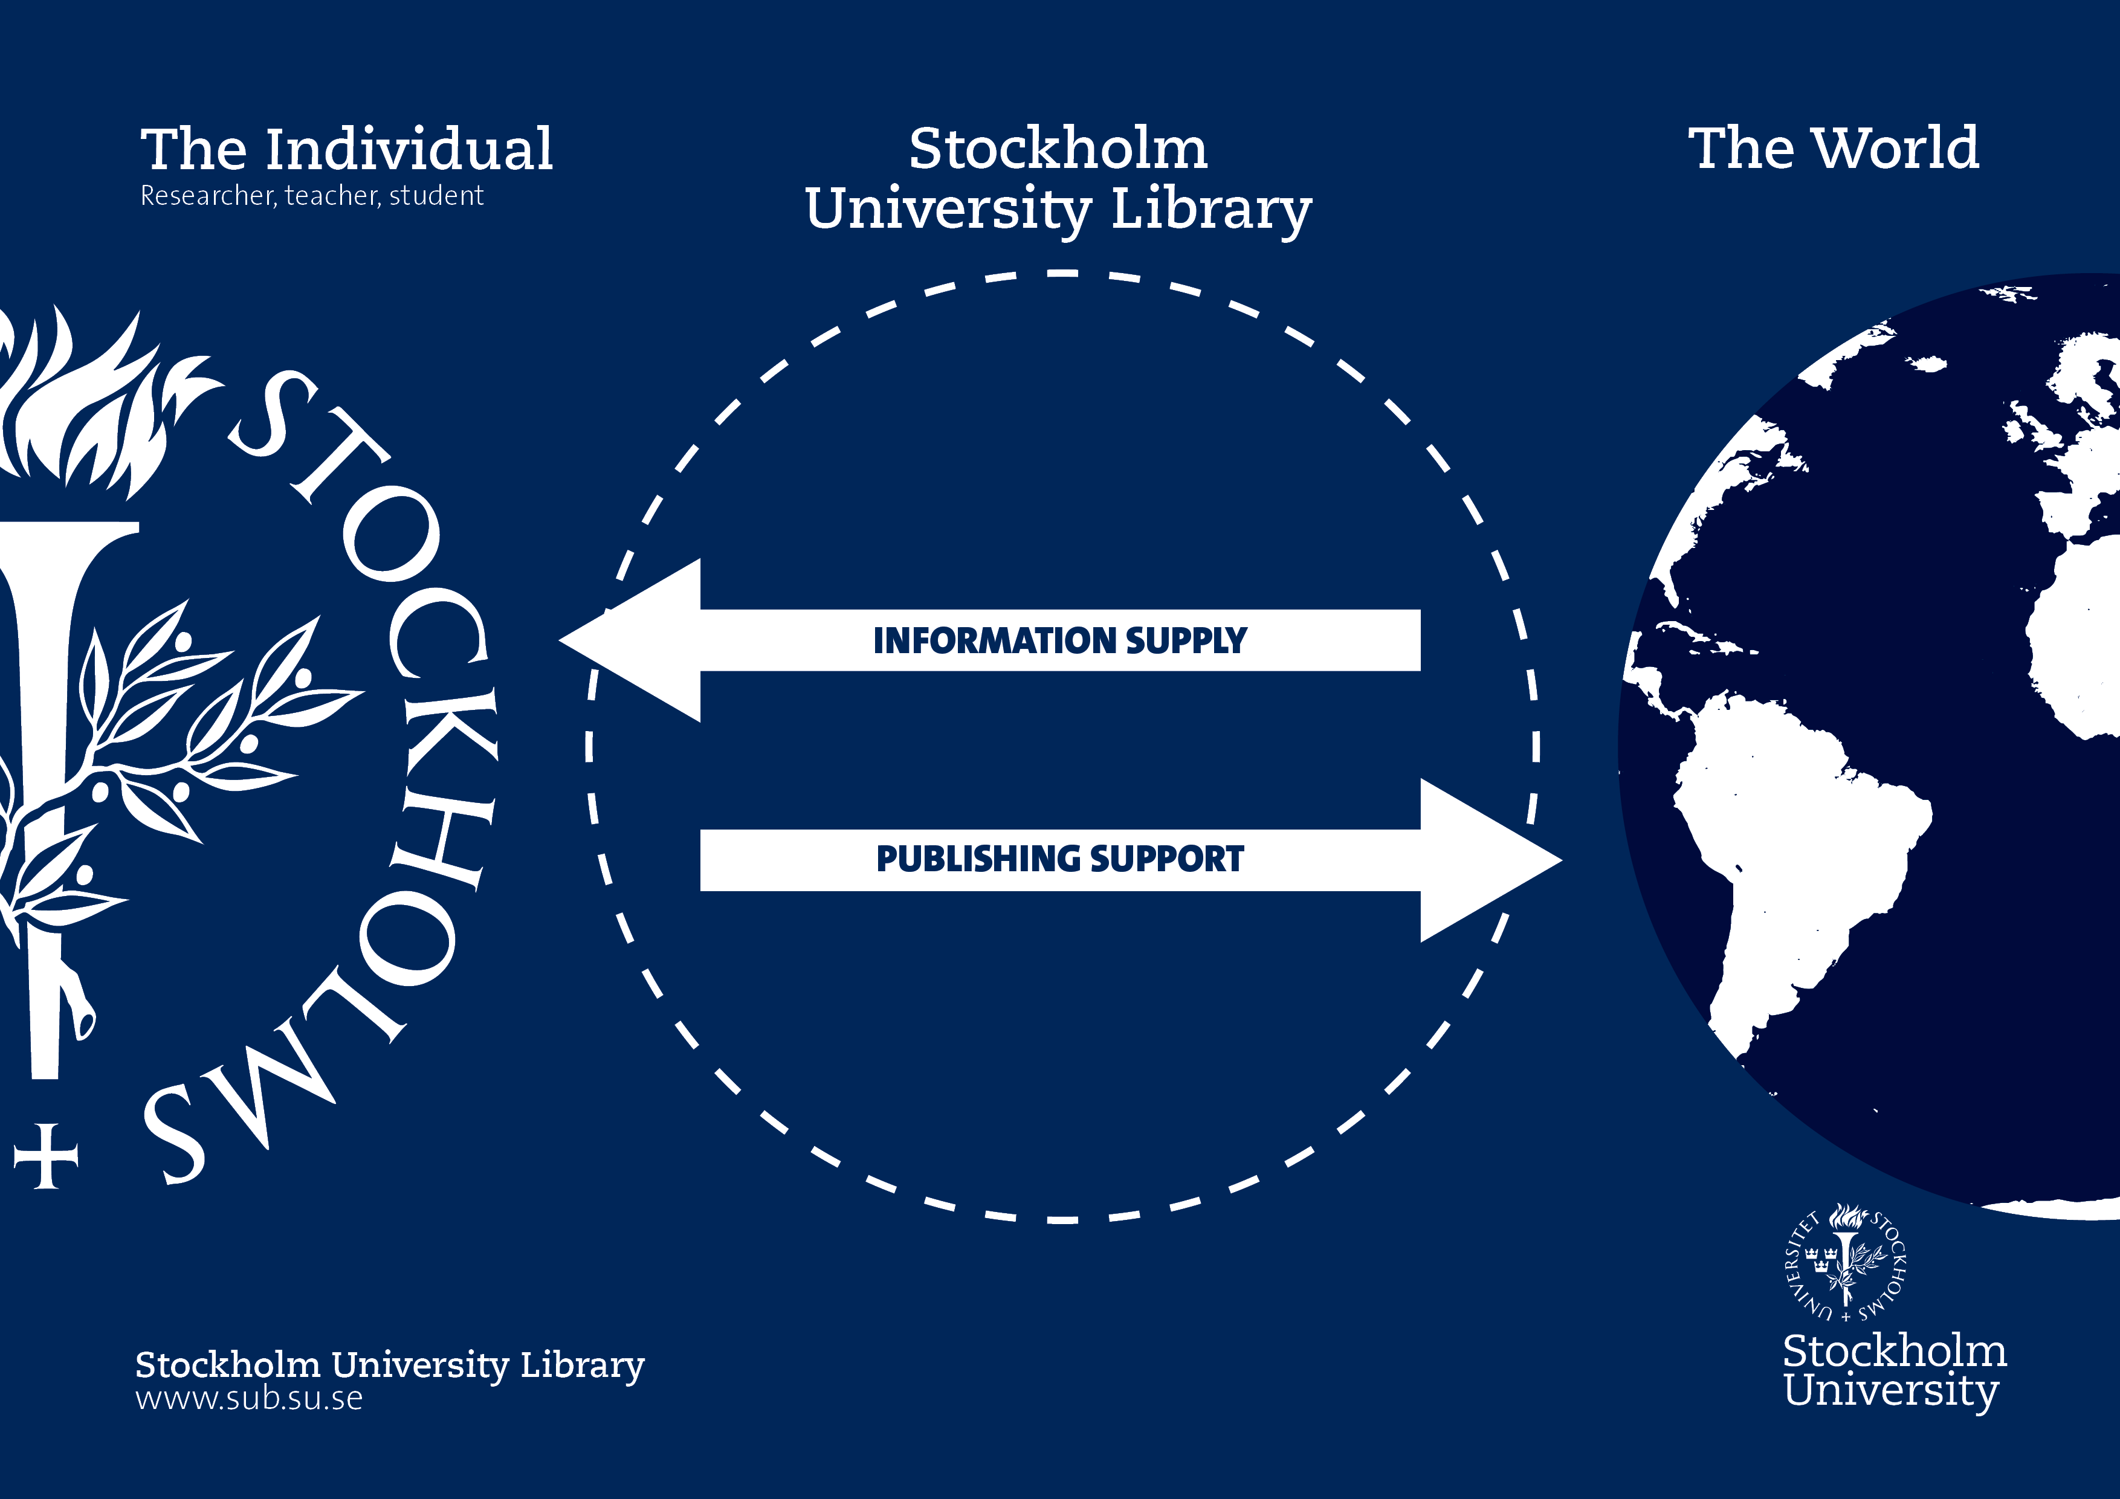
Notes:
The Library can be seen as a facilitator in the connection between the University and the rest of the world. We provide information sources and tools for the students, teachers and researchers to use. The second task is to also facilitate communication of the results of the teaching and research back to the world. We provide different forms of publishing support such as publishing dissertations and the newly started Stockholm University Press for Open Access and peer-review publishing of books and journals.
For this we have created an infrastructure of people, information and task on different levels, which I’m now going to talk to you about a little bit.

Slide 3


Slide 4
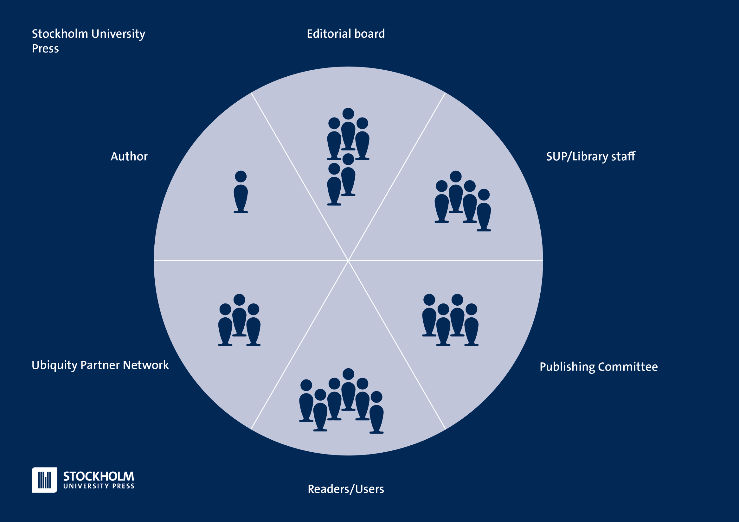
Notes:
The infrastructure of peer-review and editorial assessment.
The quality assessment process
No staff works solely with press matters, we all have other duties at the library to ensure we have a perspective (I, for example work with forming strategies for learning and instruction about all library services to both researchers and students
Researchers at the University forms Editorial Board groups who are responsible for the assessment of proposals and book manuscripts and to select and communicate with the reviewers of both these incarnations of book projects.
The Stockholm University Press staff is assisting editorial boards with system practices, guidelines, instructions, liaising with our partner press, assisting authors during submission, answering questions, handling licencing queries and many more things.
The Publishing Committee consists of representatives from all Faculties at Stockholm University and representatives from the Press staff. Their job is to establish ethical guidelines, contributing to the scope of the entire press bit most importantly they make the final decisions on whether or not to pubilsh a book or a journal. They will quality check all final recommendations from editorial boards, to ensure that the process has been correctly handled with a special representative focussing on publication ethics
The Ubiquity Press and their network structure are mostly involved with activities after the acceptance date of projects, but will also assist with the day-to-day running of journals, peer review systems but are also involved in giving advice on the editorial processes. The network of presses serves as a point of reflection and collaboration
The Readers/users of our services is also a part of the structure, as most of our ideas for improvements and development come from their comments and suggestions.

Slide 5
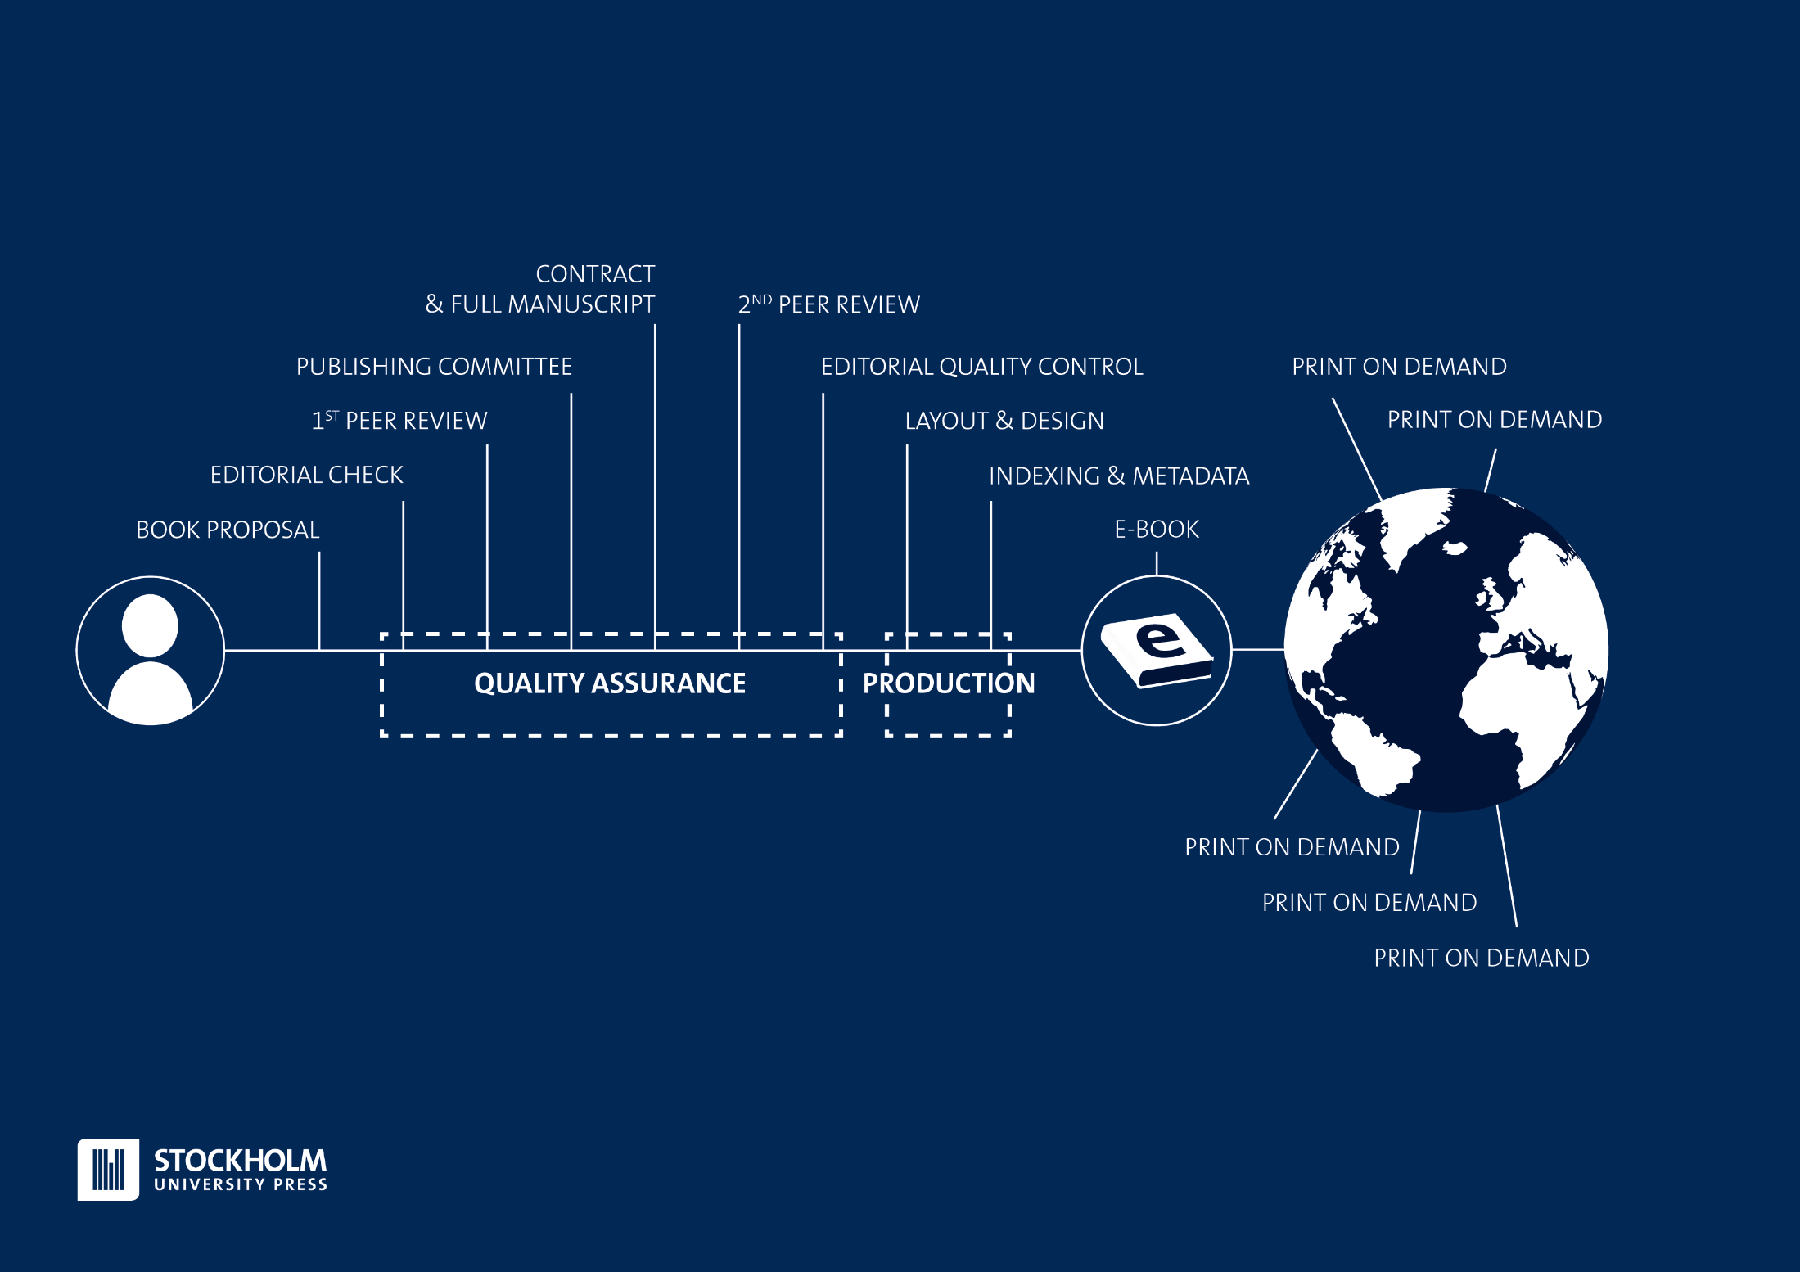
Notes:
This is the Stockholm University Press workflow for books.
The quality assurance part is done at the library and the editorial boards, the production part is handled by our partner Ubiquity Press.

Slide 6
Notes:
Managing the peer-review process of books is time-consuming and requires experience and knowledge about the entire evaluation and writing process for academic texts and data.
SUP can provide the technical infrastructure for this through the Open Source software Open Monograph Press (OMP). The SUP staff will provide support for administration and commmunication between editors and reviewers.
We have however contracted another provider to handle the technical platform as the development, support and training of the system would be too much for the library to handle.

Slide 7
Notes:
Starting, running and developing journals require a technical infrastructure to help the editors stay in contact with reviewers, authors and each other. They need an overview of the many parallel processes involved.
The process need to be documented and transparent to follow international ethical guidelines.

Slide 8
Why Start a New Press?
Vice-Chancellor initiative
External demand (Swedish Research Council, EU:s Horizon 2020, etc.)
Affordable OA publication fees
Create more opportunities for researchers to gain merit through publications
Add measurability and follow-up through close collaboration with researchers and the university
An alternative to traditional publishers
No pressure to create revenue on research outcomes
Sofie Wennström, Stockholm University Library @SofieWennstrom @SthlmUniPress

Slide 9
What’s in it for the Library?
Becoming a trusted knowledge hub about scholarly communication
(Thomas: Deeper understandning of research practices and needs)
Providing services for and about OA to an affordable price
Creating (thomas: building innovative and flexible?) infrastructures for excellence in scholarly communication
(Lisa och Thomas: prediktiva analyser inom vetenskaplig kommunikation)
Sofie Wennström, Stockholm University Library @SofieWennstrom @SthlmUniPress
Notes:
Mervärde på sikt: En visualiserad bibliotekstatistik syftar till att tillfredsställa användares befintliga behov, men också till att uppmärksamma användare på behov de kanske inte visste att de hade. Målet för oss som bibliotek är att vara långsiktigt relevant och att kunna följa utvecklingen över tid, imorgon och om fem eller tio år. (Den utvecklingen är ett forskningsresultat i sig.)
Thomas: När vi samordnar all den information vi kan komma åt från biblioteket har vi möjlighet att se trender och mönster inom vetenskaplig kommunikation. Sannolikt även vita fläckar och därmed föreslå samarbeten, publikationer och kanske även projekt tillsammans med forskarna.
Thomas: Biblioteket och dess samarbeten med andra motsvarande organisationer är väldigt rörliga och innovationsbenägna. Finns stor möjlighet att ta risker för ett stort Universitetsbibliotek utan att förlora pengar. Därför borde biblioteket vara den bästa hemmahamnen för forskardriven publiceringsintrastruktur.

Slide 10
Open Access to information!
Empower the author.
Notes:
Bilden är länkad till: https://login.bws.birst.com/apps/#/dashboards/d85c93db-7404-4f67-94d8-f27989a96728/pages/dc53a4f3-8390-4797-af99-fcd6c331a243

Slide 11
What’s in it for the Researchers?
Adding a meaning and context to publishing activities
Adding the possiblity to make comparisons on different levels
Thomas: ”How long is the life of a monograph?” (fråga från professor)
Sofie Wennström, Stockholm University Library @SofieWennstrom @SthlmUniPress
Notes:
(Kopplat till struktur: hur visualiseringar av bib-data sätter forskaren i ett sammanhang. Forskaren är van att tänka på sig själv som del i ett forskningsfält, men inte nödvändigtvis som del av en institution eller ett lärosäte. Varken i det förra eller senare av sammanhangen har den enskilde tidigare kunnat se sitt/sin bidrag/avtryck/del på ett tillgängligt och överskådligt sätt)Två sidor, både inåt och utåt – att själv se och att kunna visa upp för andra.
Sammanfattning av hittills upplevda mervärden med en visualiserad biblioteksstatistik för forskare:
Visar en forskare sin forskning i ett nytt sammanhang – en helhet tidigare inte sedd, från vilken det går att borra ned till detaljer.
Möjlighet att jämföra sig med andra institutioner och lärosäten. Lära av andras goda exempel.
Ett instrument för att få gemensamma underlag för dialog och samarbete inom och mellan institutioner.
Möjlighet att följa utvecklingen över tid.
Möjlighet för fler att följa arbete mot måluppfyllelse på olika nivåer, genom exempelvis universitetets indikatorer på mål
Varumärkesbyggande för universitetet och identitetsskapande för forskare och studenter. Ett steg mot ett mindre decentraliserat universitet.
Möjlighet för var och en att visa upp sina styrkor. Ex. olika discipliner uppvisar vitt skilda publiceringsmönster, är olika forsknings- och undervisnings­tunga, är olika tillämpade, fäster olika vikt vid grund- och avancerad utbildningsnivå. Ibland kan det vara viktigare att lyfta en enskild publikations impact story än att mäta dess antal nedladdningar, om den bara nått rätt mottagare. Då kan den vara briljant i sin kontext, trots väldigt begränsad användning.

Slide 12



Added value of ”Quality Assurance”?
External review – systems, administration and networks
Freedom of speech & Open Access
Developing good practices & routines
  Transparent
  Traceable
  Understandable
Scientific integrity
Archiving
Possibility to submit an appeal
Sofie Wennström, Stockholm University Library @SofieWennstrom @SthlmUniPress
Notes:
We are working on giving advice about practices and routines, as well as connecting people with the proper networks in relation to the external review process
We would also like to makes sure that our editors and editorial boards are well informed about ethical considerations relating to editorial and publishing processes. We ensure that all our staff and connections are aware of international ethical standards for example through networks like COPE (www.publicationethics.org)
We need to develop practices and routines that facilitates for authors and editors to follow these guidelines, and our processes should be transparent, traceable and easy understandable. All our systems are built to accomodate this.
The openess also need to be related to the importance of scientific integrity
It should for example be possible to submit an appeal for editorial decisions, and to conduct investigations of good practice based on our records.
The archiving issue is therefore a part of the quality assured workflow, as all correspondence and other records related to the process need to be well documented and secured.

Slide 13
Challenges
Local base
Global reach
Opportunities
Trust
Flexibility
Added value
Created value
Indexing
Close to home
Open Access
Making access count
Sofie Wennström, Stockholm University Library @SofieWennstrom @SthlmUniPress
Notes:
Building a new press takes time and persistence, and we still have a long way ahead of us. Working closely to the researchers interested in publishing gives us an opportunity to make the most of the knowledge gathered in editorial teams and in the press structure. We also work closely with UP to develop administrative platforms, such as OMP & OJS, with quality assured routines for peer-review and assessment.
One of our main focuses has been to think about data collection strategies from day one in our projects. This means that we will be able to give feedback to authors, faculty members and readers about our continued progress. We want all our authors, editors and users to have access to data that can vouch for their involvement in our projects and the impact of their actions. All indexing and metadata efforts will support this.
We are open to different solutions. We don’t run a “one size fits all” kind of publishing entity, which is also an opportunity we have by starting small.
Create understanding for the global landscape with local means is sometimes a challenge. We need to make sure to give arguments to authors and editors as to why it is important for them to be able to work with us
Communicating the right thing at the right time to get engagement is not an easy task, and this is a little bit of a trial-and-error venture. We have to make sure to catch comments and suggestions to constantly improve our services and to adjust to the needs of the authors and editors.
Relating to the greater publishing community in our approach is a challenge as we are starting small and it takes a long time to see impact in the form of citations and tracking down shared data. We need to focus on this in order to give proper value back to authors and editors in the form of publication data, which is also related to the rest of the institution’s needs.
Creating data, open distribution channels and provide proof of quality assurance is a challenge, as this need to be communicated clearly and should be easy accessible.
Indexing and metadata need to happen in relevant channels and by using the knowledge we have in collaboration with researchers in order to give them maximum visibility. This includes a large amount of data and administration that is being built as we go along.

Slide 14
Questions for bee-hive
What are your thoughts on added value for the library?
How would you work to lead development to the benefit of the researcher?
How do you use statistics in your organization?
Sofie Wennström, Stockholm University Library @SofieWennstrom @SthlmUniPress

Slide 15
What is left to do?
More learning objects (digital, examples)
Keep building the good examples
Center of excellence in close collaboration with researchers and teachers
Sofie Wennström, Stockholm University Library @SofieWennstrom @SthlmUniPress

Slide 16
Extra slides at the end

Slide 17


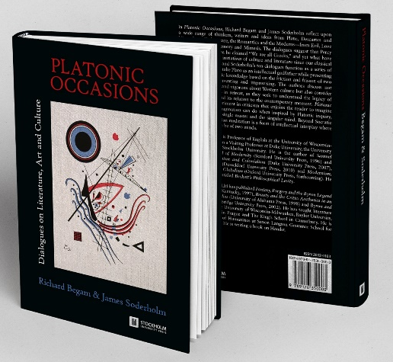

Stockholm University Press
Peer-Reviewed
Print-on Demand
15-06-23
Sofie Wennström, Stockholm University Library @SofieWennstrom @SthlmUniPress
Notes:
We publish: Academic Journals, Books/Series & Anthologies – so far 2 books in English studies and one journal in Geography
All content has to be peer-reviewed – articles, book chapters & book proposals alike
The publisher/library provide infrastructure and strategic support to the editorial boards, who in turn takes care of the quality assessment and review process of proposals and books.
We have an agreement with Ubiquity Press about production (electronic & print), distribution (mainly to databases), & print-on-demand services
Open Access-publishing of all products, where CC-BY licence is recommended. However, we sometimes use other cc-licences if our researchers need it.

Slide 18
Making peer review count
Poster presented in March 2014 at the Library Publishing Forum in Kansas City, USA:
http://jlsc-pub.org/lpc14/14/
Thomas Neidenmark,
Stockholm University Library @thomasneiden @SthlmUniPress

