Slide 1


Publishing For and By Researchers
– But why Library Publishing?
Sofie Wennström
Analyst, Dept. of Quality, Stockholm University Library
@SofieWennstrom | @SthlmUniPress
sofie.wennstrom@sub.su.se
Notes:
I’m an Analyst at the University Library, with a background in Publishing (at one of the biggest international academic publishers), and currently also a Postgraduate student in Education.
AGENDA:
I’d like to talk to you today about the governing principles of the publication services at Stockholm University Library, by using the Stockholm University Press as an example.
I’m going to elaborate on the reason why we started a new press at Stockholm University in 2012/2013 and what the strategic drivers are for us to run and develop our operation.
After the initial strategic view, I will go into a little bit more detail and talk about how our press is governed by the researchers and administrated by the Library.
I will demonstrate a few cases on how far we have come after the first couple of years.
Lastly, I will talk a little bit about the challenges and opportunities for us going forward.

Slide 2

Notes:
Stockholm University has about 29,000 full time students of which 62% are women, the total amount of students is 69,000 including part time and distance studies.
The university offers 194 educational programmes, and about 1,700 courses.
87% of the students are enrolled in courses and programmes within Humanities & Social Sciences, 13% in sciences.
There are about 3,500 academic staff (66% of total staff) employed, of which most are both teaching and doing research
Currently, there are 1,780 PhD students enrolled, of which 84% are related to the faculties of Social Sciences, Humanities and Law and 13% to the Faculty of Science.
We’re ranked as one of the top 100 universities in the world by the Times Higher Education Ranking.
Most of our operations are funded by the Swedish state, mainly through grants from the Governmental Department of Education and the Swedish Research Council, but there are some external funding as well.
The strategies for 2015 to 2018 is to continue to nurture the excellence of the fundamental research, at the same time as we grow into a modern university without compromising the academic values while supporting both national and international collaboration.
The founding principles, since 1878, is openness, accessibility and a close connection to the society as a whole, and this is something that is very much related to the Stockholm University Press, which I’m moving onto now.

Slide 3

The Press as a part of the University
Notes:
Stockholm University Press is a part of the University Library, and by that also a part of the university as a whole.
In order to support the strategies laid out in the previous slide, it was decided there was a need an upgraded publishing service for our researchers, and there was a demand for more Open Access options.
The press was thus formed in 2013, based on a decision of the Vice-Chancellor, and its governance and operation was placed at the Library
An early decision in the process of forming the press, was to ensure it had a clear focus on the users, i.e. the researchers, to ensure that it was closely related to their needs.
At that time, the university already had a couple of publishing operations: 1) Acta Universitatis Stockholmiensis, administrated by the Library, for dissertations and somewhat peer-reviewed books and series, and 2) HLS Förlag, which was the publishing entity placed of the Teacher’s college that merged in with the university, which mainly dealt with text books for teachers’ education. These two operations were closed and some of the HLS Publishing staff moved to the Library.
In the previous structure, there was no open access option, no control over the quality assessment process, and most importantly no home for academic journals.
The Stockholm University Press has since then been allowed to grow organically, and in accordance with the users’ needs of research communication.
We publish peer-reviewed and academic books and journals, online-first, but with a print-on-demand function for books (distribution through Amazon and Swedish book agents)
The current operation is run by five Library staff, of which none of them are dedicated to only working with publishing matters. However, some further expertise in academic publishing was added to the staff profile in 2014 (i.e. me) to further ensure that an alternative to the traditional publishing outlets was put in place, while making sure that the quality assessment process is of the highest standard.
Publishing of dissertations from Stockholm University is also managed by the University Library, but not under the Stockholm University Press brand.
The platform for publishing of grey area literature, reports and other miscellaneous works by researchers is currently being built, with a current plan for release in late 2016 or early 2017.

Slide 4


Key Drivers for the Press
Researcher-driven publishing without barriers
A non-profit approach to publishing
A local Open Access Publishing partner for global reach
New mandates for Open Access/Open Science requires alternatives to costly traditional publishers
Supporting local scholarship by a robust model for quality assessment, impact & distribution of research output
Notes:
So, what are the key drivers for this publishing entity as a part of the library and university?
Researcher-driven: supports global dissemination and provides platforms for peer-review and further collaboration
A true non-profit organisations allows for other drivers than the current market, it is the need for knowledge and dissemination that should be making the calls
Open Access is a given, as a National mandate is expected to be in place by 2017 and as this is one of the founding principles of the entire University. There should be no lock on knowledge.
Educating academics through creating good examples – the publishing tradition at Stockholm University is diverse, as the different faculties have different needs (for example, publications in Swedish and other languages than English).
Building guidelines that explains why – international guidelines on publication ethics and best practices of publishing are high up on the agenda in order to ensure best practices
Learning through these good examples and metrics – showing results openly.

Slide 5
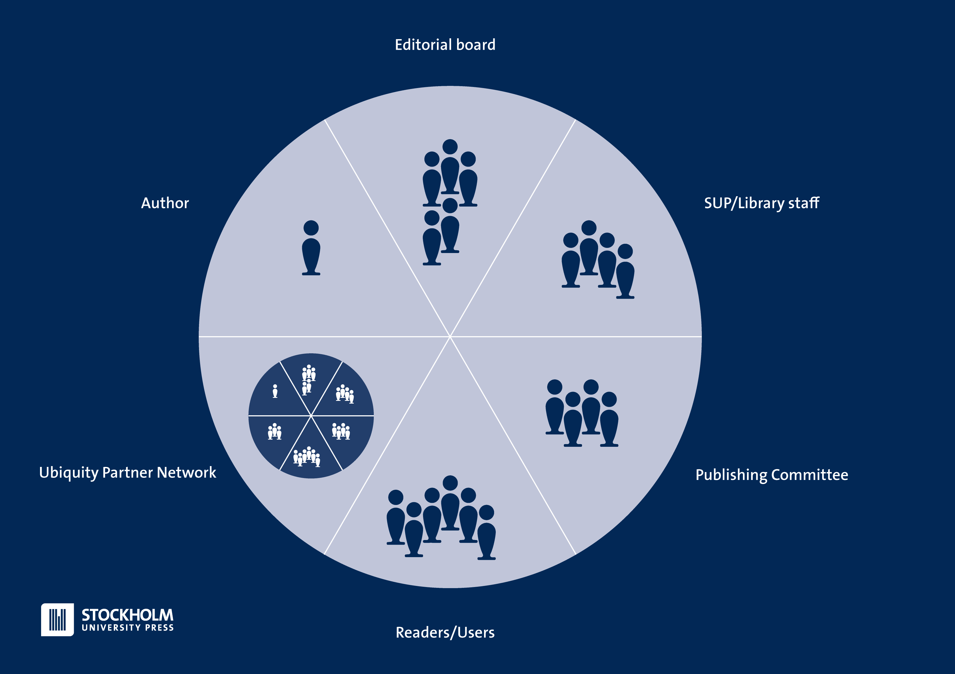
Working Structure
Notes:
In order to out further emphasis on the researcher-led publishing, the editorial structure of the Press is built on the collaboration between the different stakeholders of the process
The Publishing Committee include elected members of senior faculty along with representatives from the Library staff. Their job is to establish ethical guidelines, contributing to the scope of the entire press bit most importantly they make the final decisions on whether or not to publish a book or a journal. They will quality check all final recommendations from editorial boards, to ensure that the process has been correctly handled with a special representative focussing on publication ethics
The governing bodies, Editorial Boards, of book series and journals is formed by researchers, who is responsible for the editorial processes.
The Editorial Boards are formed of active researchers in each respective subject area, based on their own ideas and scope. It is also common to recruit board members from other institutions or countries, to facilitate networking and external review
External reviewers – no one can review a manuscript from their own department or institution, so all reviewers should be invited on this premise, based on the networks of the board members
The administration is a part of the university, and thus have access to databases and information channels to facilitate the support to researchers as authors, editors and reviewers
No library staff works solely with press matters. They have other duties at the library to ensure that the perspective about the meaning-making process is in place (I, for example work with forming strategies for learning and instruction about all library services to both researchers and students)
Working structure:
Authors submit papers, proposals and full manuscripts
The Editorial Boards assess the manuscripts and appoints reviewers and make decisions or recommendations of decisions (the structure is a little bit different between journals and books)
The Library/Press staff facilitates the process and run the day-to-day management
The Publishing Committee makes final decisions about proposals (books and journals) and book manuscripts
The Journal Editors make decisions about the acceptance of single articles
The Readers/Users are a part of the cake, as they can come with feedback through open commenting sections, and by analysis of usage patterns
The different pieces of this cake interlaces with each other, and the press processes are built to facilitate these interactions, by for example online systems for handling the review process for books and journals.
We share these systems with the network of presses belonging to the Ubiquity Partner Network, and can thus take advantage of developments being made without having to focus on them ourselves, so they also make a part of the same delicious cake.
The Stockholm University Press staff is assisting editorial boards with system practices, guidelines, instructions, liaising with our partner press, assisting authors during submission, answering questions, handling licencing queries and many more things.
The Ubiquity Press and their network structure are mostly involved with activities after the acceptance date of projects, but will also assist with the day-to-day running of journals, peer-review systems but are also involved in giving advice on the editorial processes. The network of presses serves as a point of reflection and collaboratio.
The Readers/users of our services is also a part of the structure, as most of our ideas for improvements and development come from their comments and suggestions.

Slide 6
Notes:
Stockholm University Press currently publishes four Journals, of which two have published content, Designs for Learning (Education Science) and Rural Landscapes (a combination of Human and Natural Geography). As you can see here.
This particular journal, Rural Landscapes, was started together with researchers at the Department of Human Geography at Stockholm University. They have published 7 articles in a little over a year, and are now picking up on speed
The journals published with us get support to build a platform like this one, for online distribution and editorial assessment, strategic advice to build an editorial structure and dissemination plan, advice on best practices for journal publishing in a global landscape as well as professional production services, with the help of our service partner Ubiquity Press

Slide 7

Journal Usage Q1 2015-Q2 2016
Notes:
The usage statistics of the content published so far is summarised per journal is shown in this graph.
Note that Designs for Learning has been publishing their content with Stockholm University Press since January 2016, where the journal archive was moved from another publisher. Currently holds an archive of about 65 articles.
The Journal of Montessori Research & Education and the Scandinavian Journal of Work and Organizational Psychology have yet to publish any papers, but the sites are up and running and they are open for submissions. Both these two new starts shows promise, as they are both attracting thousands of online visitors without even having added content yet.
Since the majority of our journals are starting from scratch, and most of the contracts was signed in 2015, it has taken a while before the
The total cost of publishing services are GBP 300 per article, and no overhead is charged by the Library.

Slide 8
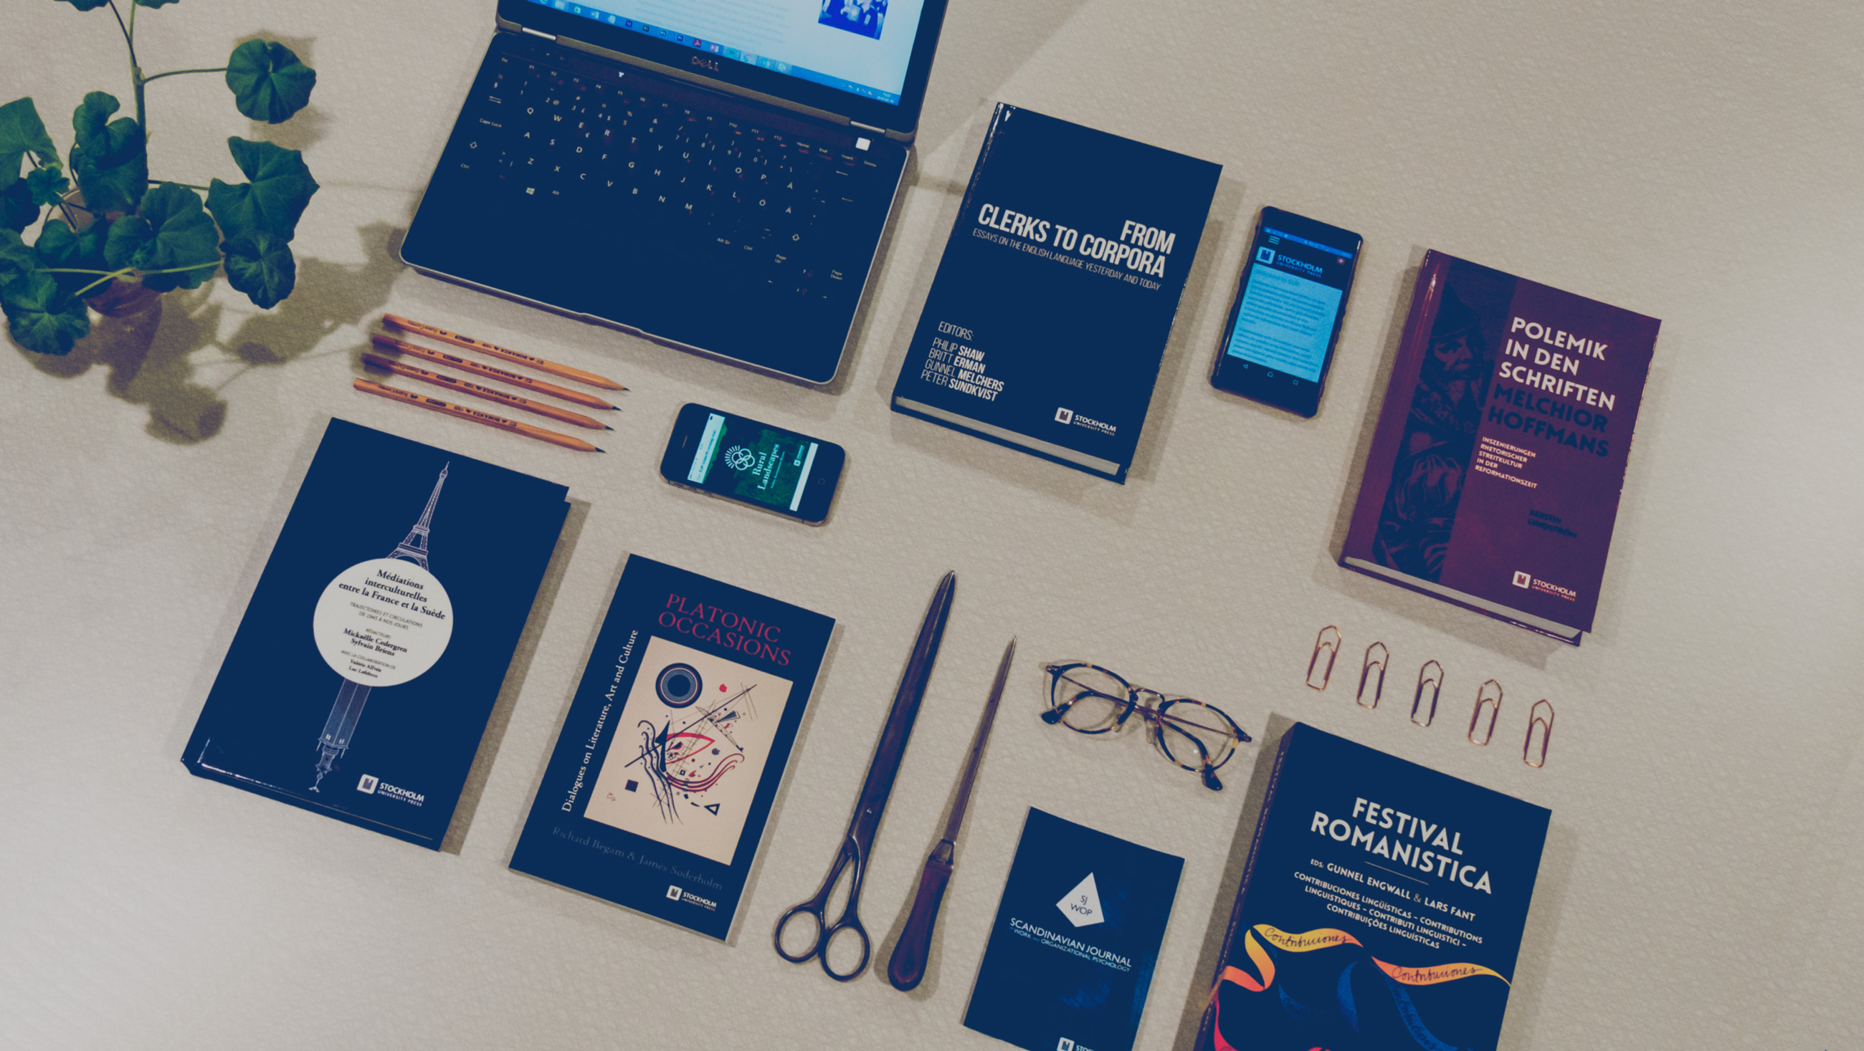
Notes:
The books are commissioned in close relationship with the Editorial Boards per subject area. Their publishing plan is based on the need for research communication within each specific area.
We allow books as a part of a series or single projects, as long as we can provide a quality assessment structure, with limits to subject areas or quantity.
Currently, we have a contract with three Editorial Boards for book series: Stockholm English Studies, Stockholm Studies in Romance Languages and the Stockholm German and Dutch Studies. There are discussions ongoing with Editorial Boards within Didactics, History, Culture & Aesthetics, Latin, Theatre studies, Economic History and a few more. As you may notice, the current need seems to be for books within the Humanities, as that has been an area previously mostly interested in smaller works in local languages, but they are now interested in open access and further dissemination and collaboration.
A book project normally costs about GBP 3,250 (70,000 words, 20 images, or about 200 pages)
It is still hard to say something about the time it takes to publish a book with Stockholm University Press, as we do not have enough data to do a statistical analysis, but on average it takes about 6 months to a year from submitted proposal to a published book.
A new online platform for the editorial and production processing built by Ubiquity Press was released in February, which further adds a quality aspect to the editorial assessment work as well as ensuring a better transparency for authors, reviewers and editors.

Slide 9
Usage per Book & Format
Additional Usage from OAPEN Library: +679 downloads
Notes:
This is the usage statistics we have collected so far for our book projects, from February 2015 until March 2016.
Note that these books have not all been published at the same time, so some of the books have only had a few months to gather usage. The print-on-demand figures are yet to be delivered.
The book projects are (all published as a part of a book series from departments at Stockholm University):
Polemik in den Schriften Melchior Hoffmans – in German, December 2015
Médiations interculturelles entre la France et la Suède – In French and Swedish, December 2015
Festival Romanistica – in French, Italian, Portuguese & Spanish, June 2015
From Clerks to Corpora - in English, February 2015
Platonic Occasions – In English, January 2015

Slide 10

Supporting the Communicative Practices
Notes:
As the meaning-making of research & publishing would be the opportunity for academics to exchange ideas in order to improve their research
The scientific process is driven by creating possibilities to discuss and develop ideas into something greater through communication
This process is built-in to the university systems, where publishing plays an important part not only to drive development but also by the evaluation practices.
A publishing venture at a university need to take all this into account and make sure to follow this practical syllogism
Science isn’t done until it’s communicated! (Sir Mark Walport, UK Science Chief, at LIBER Annual Conference 2015, London, UK):
Our role as a publisher is then to simplify this process to leave more room for the actual research being done. But, what are the challenges and opportunities for us going forward?
Challenges:
Keeping a high quality standard in order for academics to gain merit through publication
Supporting researchers to find funding for publishing
Building a sustainable platform for publishing within a diverse range of subject areas
Opportunities
The need for a decently priced Open Access alternative is high, and we can provide it.
Online platforms for better transparency in academic publisihng – it is no longer something local and internal
The researchers are in more control of their research output, which creates further motivation to communicate their results to a wider audience – Sharing is caring!

Slide 11
Thank you – Questions?
Useful Links
www.stockholmuniversitypress.se
http://blog.stockholmuniversitypress.se
http://www.su.se/english/
http://www.ubiquitypress.com
http://www.oapen.org/home
Follow our development
Notes:
I’ve deliberately planned my presentation a little bit shorter than what the program allows, since I’m also here to get feedback from you on these thoughts about our role as a university press. What do you think we should do? What do you think the researchers need? Why do they need it?

Slide 12
Additional slides for reference

Slide 13
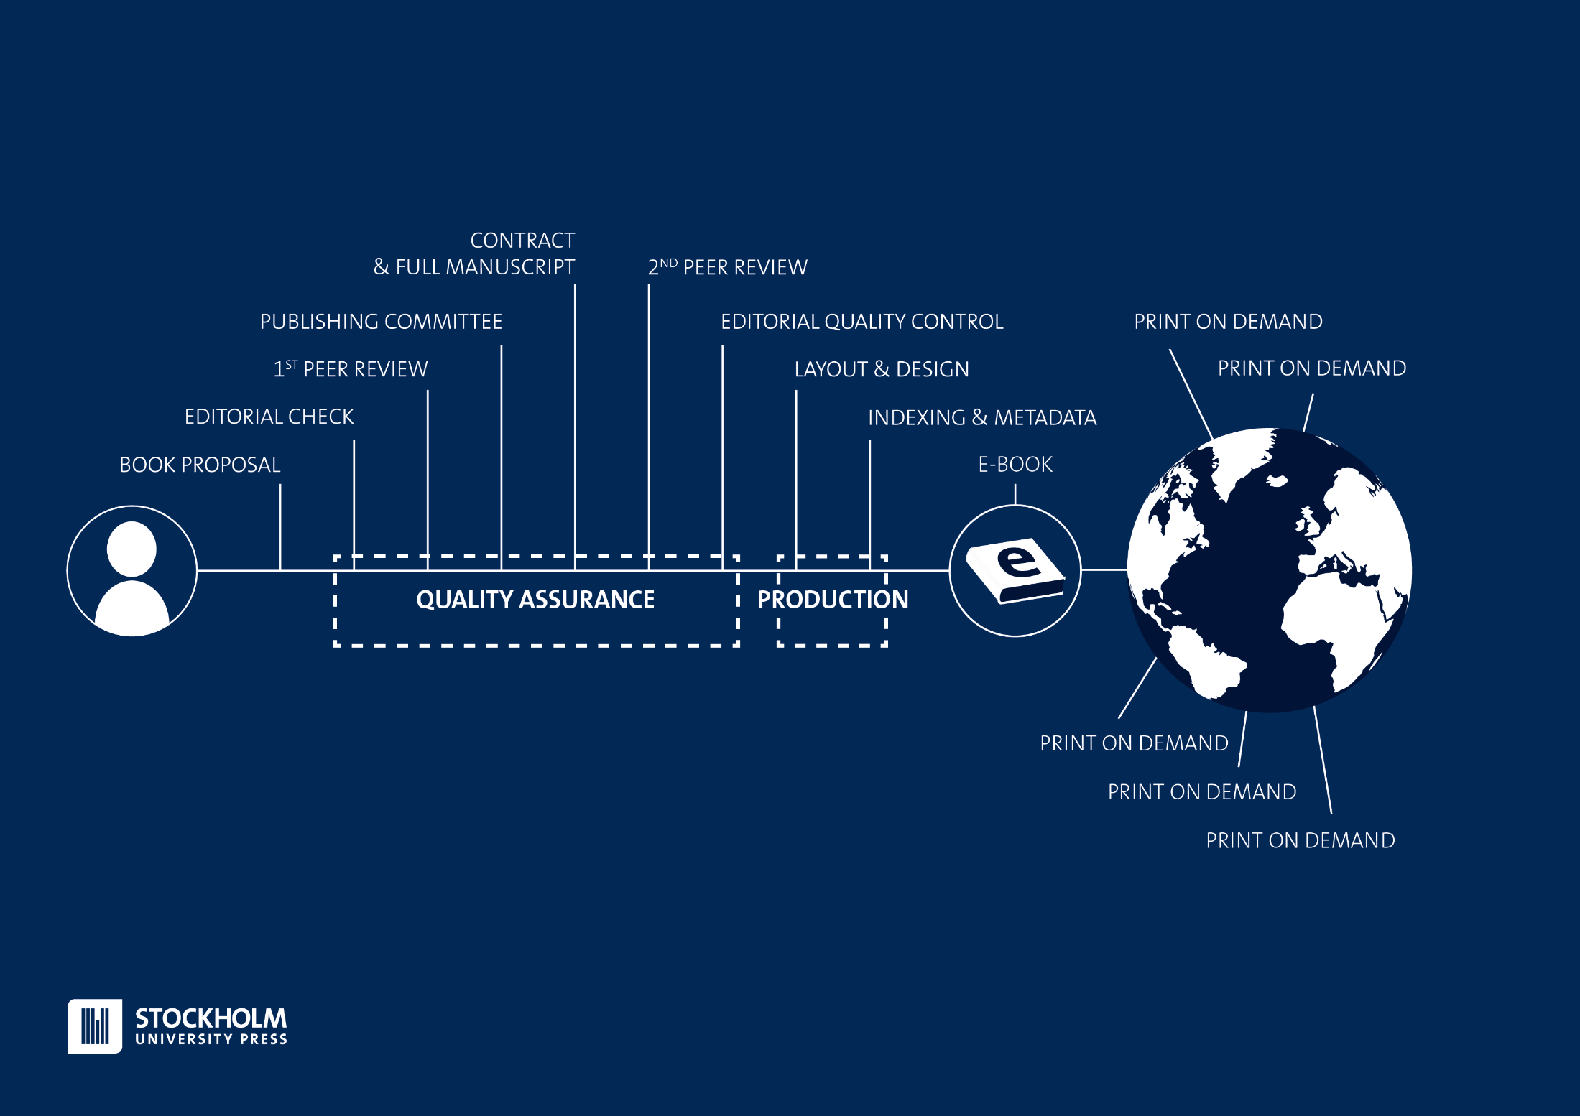
Notes:
This is the Stockholm University Press workflow for books.
Starts with a proposal → through a first screening by editors and reviewers → decision in Publishing Committee → if accept then a contract with the authors and full manuscript submission → the second review process (can include the same reviewers as for the proposal) → Author correct suggeted revisions → Final assessment by Editorial Board and Publishing Committee → Publish e-book with print-on-demand option through for the major online book stores (Amazon, and Book info in Sweden etc.)
The quality assurance part is managed by the library/press staff in close collaboration with the editorial boards, by way of the online systems
The production process (typesetting, copy-editing, printing) is managed by our service partner Ubiquity Press.
SUP adds a layer to the process by providing a home for the strategic planning of editorial work and system management though UP.

Slide 14
Common Questions
The cost of publishing?
  GBP 300 per journal article
  Approx. GBP 3,250 for a standard book (200 pages)
Who makes decisions?
  The Publishing Committee, based on recommendations from the editorial boards
Which subject areas do you cover?
  All the areas where there’s a demand for reasonably priced OA publishing
  An Editorial Board for the subject area is also needed
What dissemination channels do you use?
  OAPEN for online books
  Amazon (INT) & Bokinfo (SWE) for Print-on-Demand books
  Subject area databases & Search Engine Optimisation for journals (takes time to fulfil criteria)
Approved by the Norwegian Register for Scientific Publishers (Level 1) & The Danish Bibliometric Indicator
What organisations are you members of?
  OASPA,DOAJ, Ubiquity Partner Network, CrossRef & COPE (the last two via Ubiquity Press)

Slide 15
Page Views & Visitors per Journal
Notes:
The Journal of Montessori Research & Education and the Scandinavian Journal of Work and Organizational Psychology have yet to publish any papers, but the sites are up and running and they are open for submissions. The latter is about to publish its first articles in a few weeks. Designs for Learning publishes with Stockholm University Press since January 2016.

